Slide 1

A Project On
BLOG USING FLASK IN PYTHON
Submitted By
1.Prathamesh P Mandavkar
2. Shreyas S Phansalkar
3. Pruthviraj R Chavan
4. Dhruv S Sambrekar
5.Ganesh S Pawar
Under the Guidance of
Prof. Shrikant Bhopale
Department of CSE(DATA SCIENCE)
Dr. D. Y. Patil Pratishthan’s College of Engineering
Shivaji University, Kolhapur
2021-2022

Slide 2
BLOG WEBSITE IN PYTHON
What is a Blog?
Definition | Meaning of blog:
A blog (a shortened version of “weblog”) is an online journal or informational website displaying
information in reverse chronological order, with the latest posts appearing first, at the top.
It is a platform where a writer or a group of writers share their views on an individual subject.
WHAT IS A FLASK IN PYTHON?
-Flask is a micro web framework written in Python.
-It is classified as a microframework because it does not require particular tools or libraries.
-It has no database abstraction layer, form validation, or any other components where
pre-existing third-party libraries provide common functions.
However, Flask supports extensions that can add application features as
if they were implemented in Flask itself.

Slide 3
Advantages of Flask-based systems
#higher flexibility.
#higher compatibility with latest technologies.
#high scalability for simple web applications.
#technical experimentation.
#customization.
#slightly higher framework performance.
#easier to use for simple cases.
#smaller size of the code base.

Slide 4
The Benefits of Blogging for Business
1.It helps drive traffic to your website.
2.You can repurpose blog content for social media.
3.It helps convert traffic into leads.
4.It drives long-term results.
5.Blogging helps with link building.
6.It drives long-term results.
7.It helps you share company news.

Slide 5
What is a framework ?
A framework is a structure that you can build software on.
It serves as a foundation, so you're not starting entirely from scratch.
Frameworks are typically associated with a specific programming language and
are suited to different types of tasks.
Let's say you're building a house.
You could pour the foundation and frame the house yourself.
It would take a lot of time, but you could do it.
In software development, a framework serves a similar purpose.
It's designed and tested by other Software Developers and Engineers,
so you know it's a solid foundation.

Slide 6
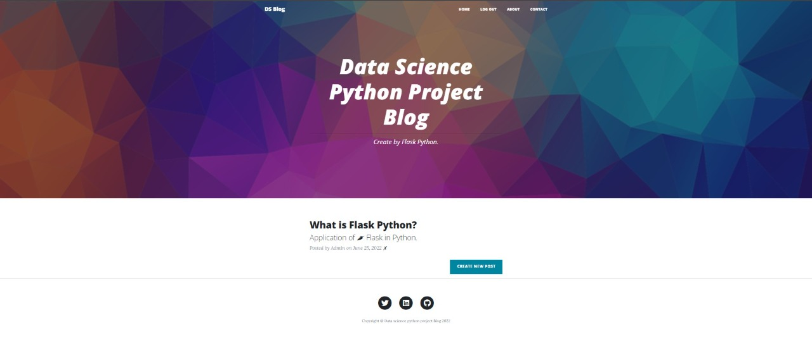
STRUCTURE OF THE BLOG
Home page-

Slide 7
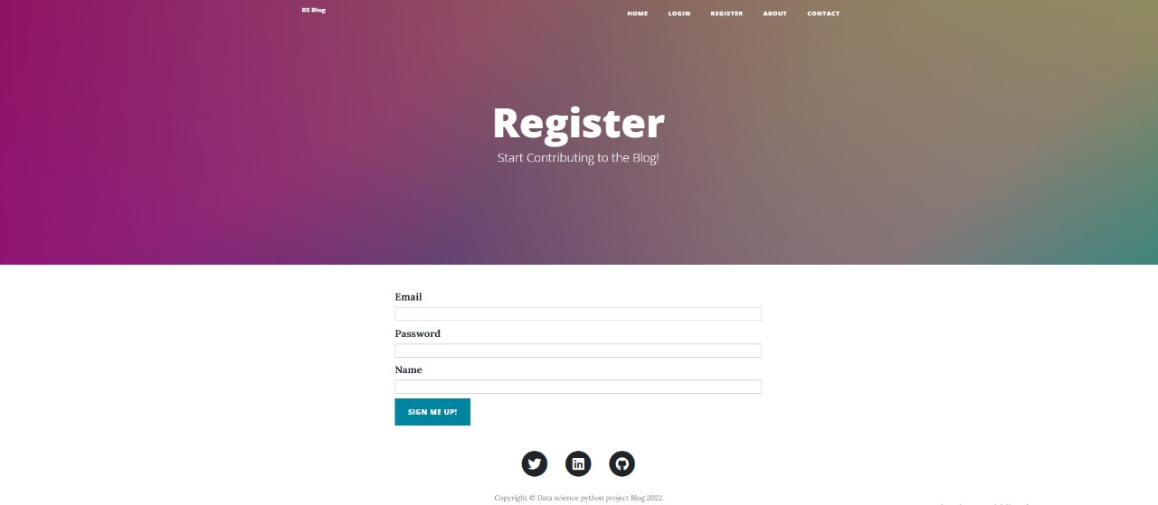
Register page-

Slide 8
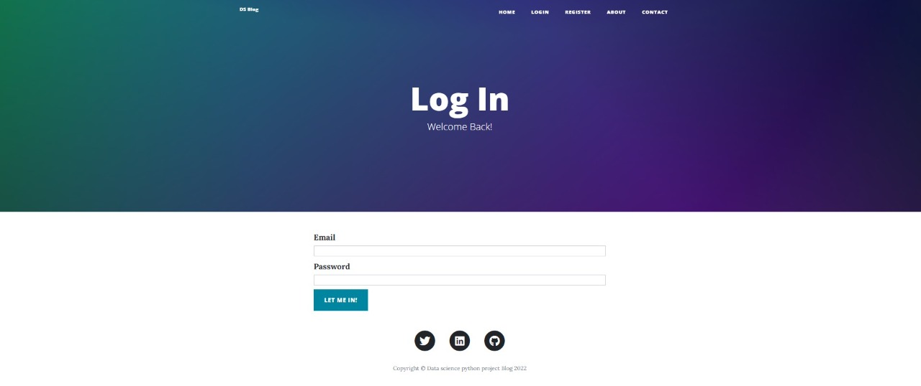
Login form-

Slide 9
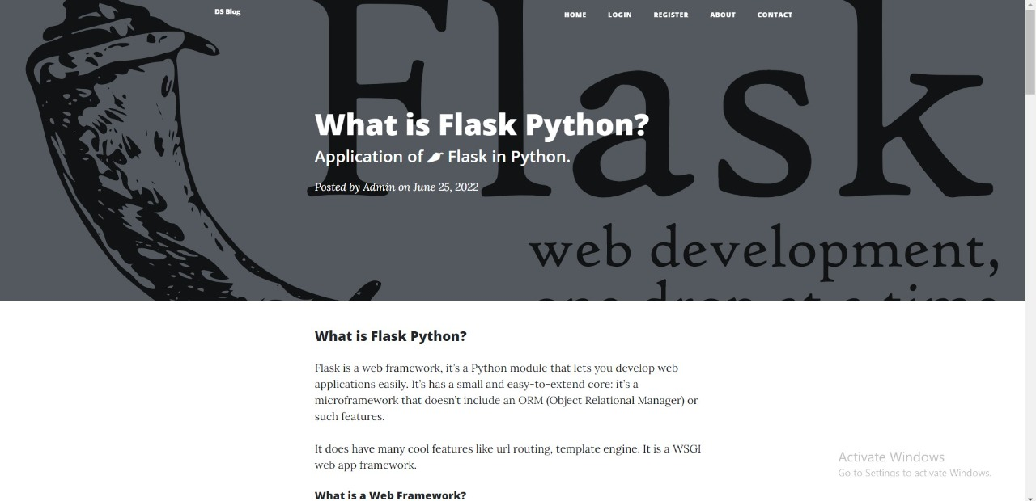
Post page-

Slide 10
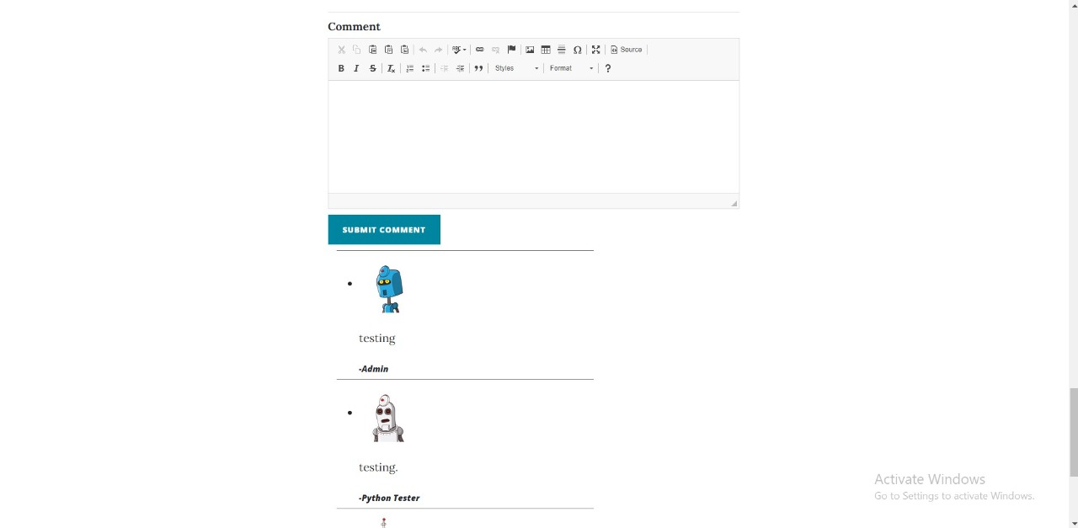
Comment box(post page)-

Slide 11
Admin-login
(Homepage)

Slide 12
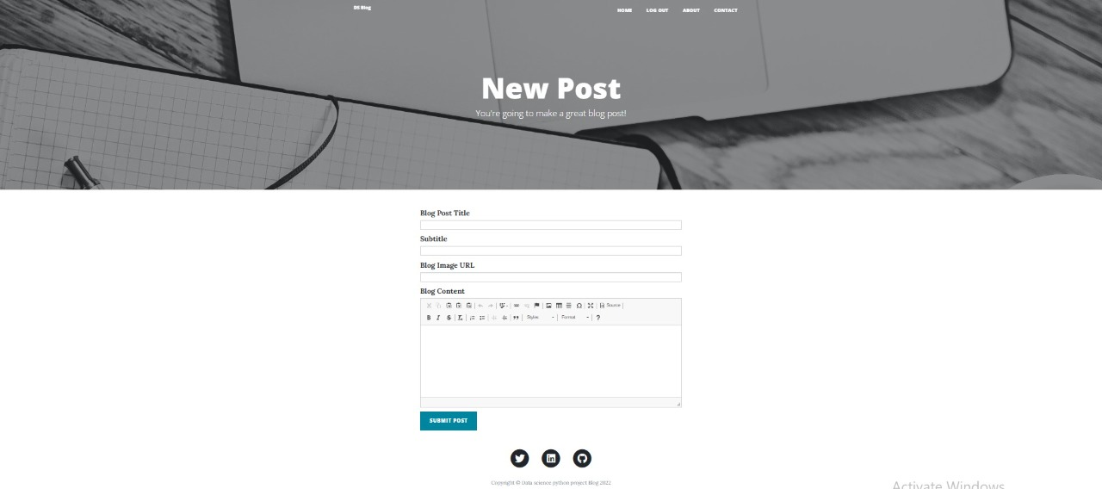
Admin-login
(new post)

Slide 13
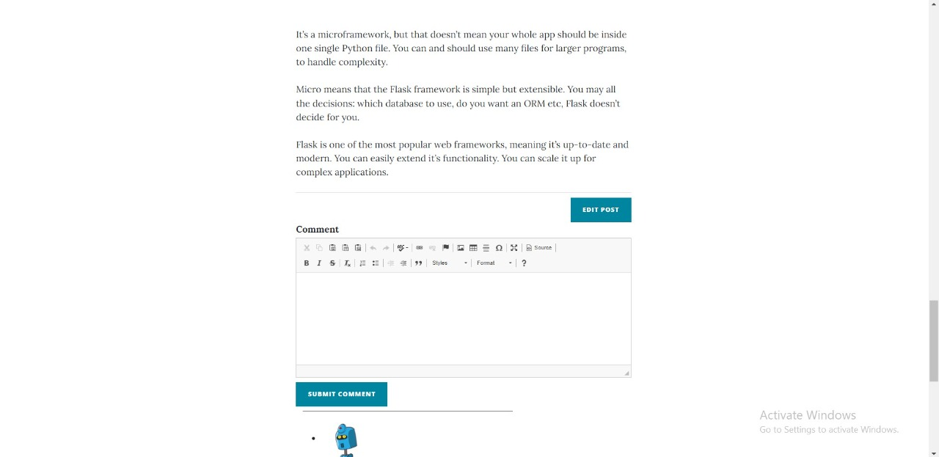
Edit blogpost-
(admin login)

Slide 14
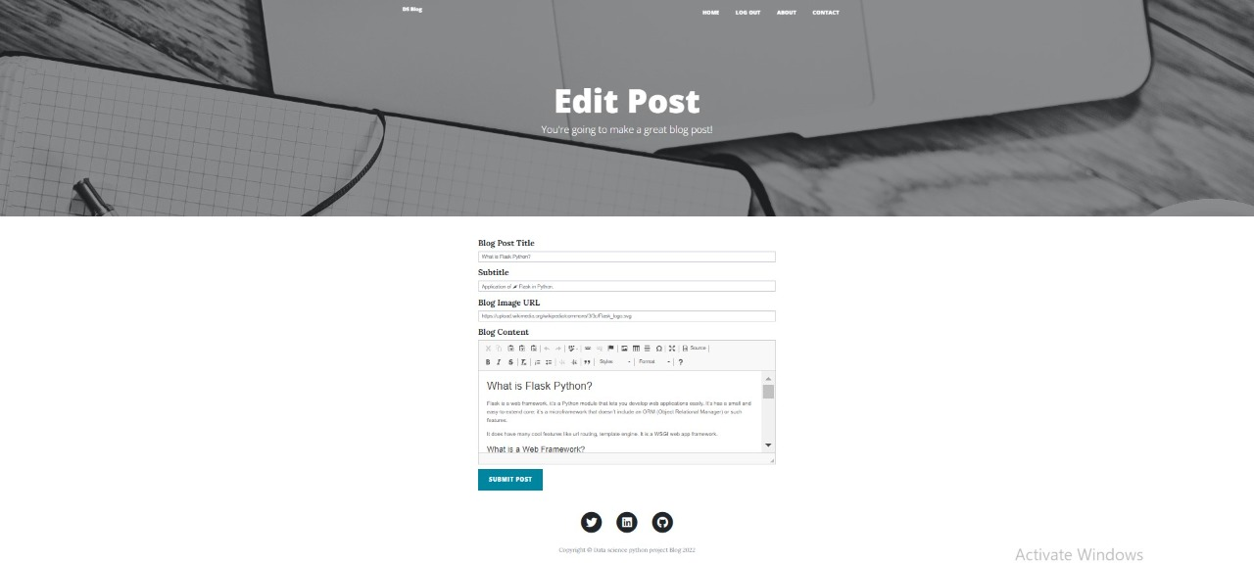
Editing blog post-
(admin login)

Slide 15
REFERENCES:-
100 Days of Code: The Complete Python Pro Bootcamp for 2022:-https://www.udemy.com/share/103IHM
FLASK DOCUMENTATON:-
https://flask.palletsprojects.com/
GINGA DOCUMENTATION:-
https://jinja.palletsprojects.com/

Slide 16
THANK YOU!

